Slide 1
Image Classification using Machine Learning
Andrew & Liam Fletcher
SISTEM, 29th February 2020

Slide 2
Agenda
Introduction
Our aim today
AI, Machine Learning & Deep Learning
Deep Learning Neural Networks for Image Classification
What do we need?
The Process & The Parts
Dataset
Pre-Processing
Model
Training & Evaluation
Using our model.
Demo
Have a go

Slide 3



Introductions
Andrew Fletcher.
Senior Software Engineer using Net/C#.
Keen interest in AI and Machine Learning
Attended a number of Hackathons and Meetups
Liam Fletcher.
Level 3 Computer Science @ QUB
Part-time Software Engineer
Keen interest in AI and Machine Learning
Attended a number of Hackathons and Meetups

Slide 4
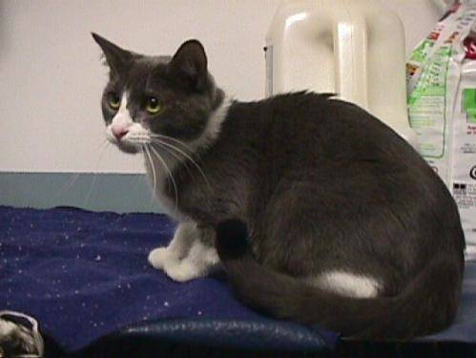
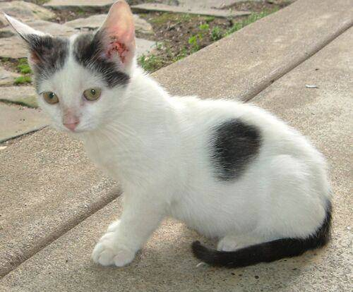
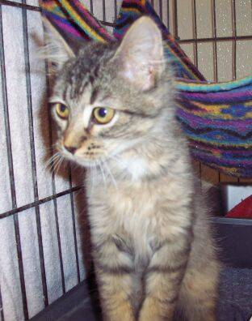
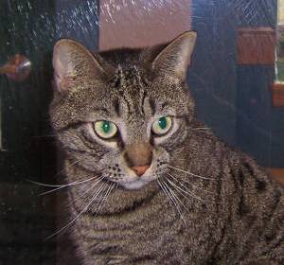

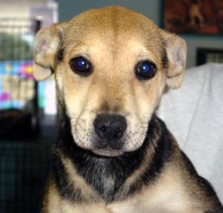
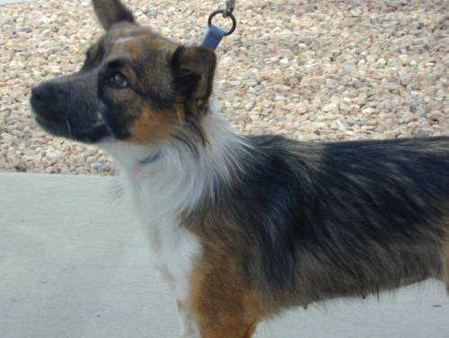
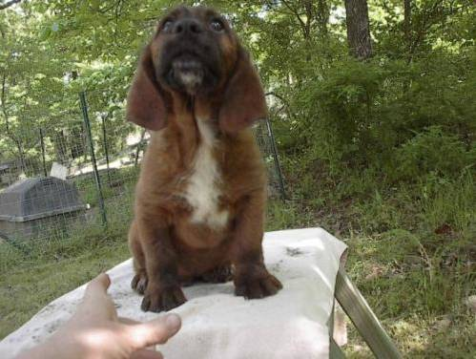
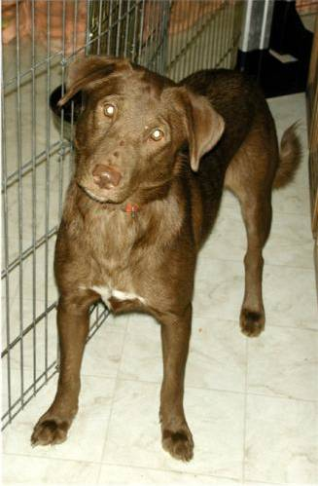
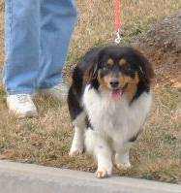
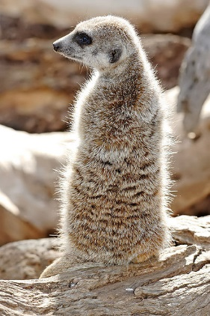
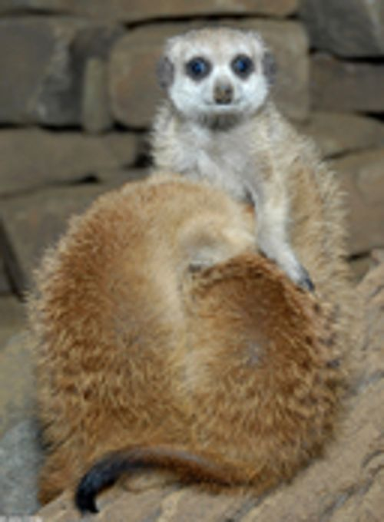
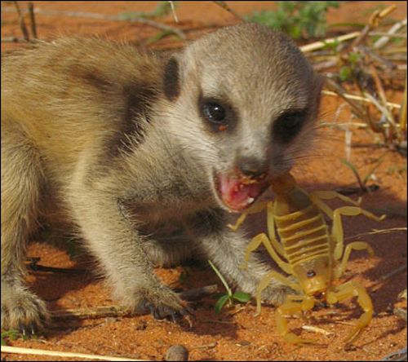
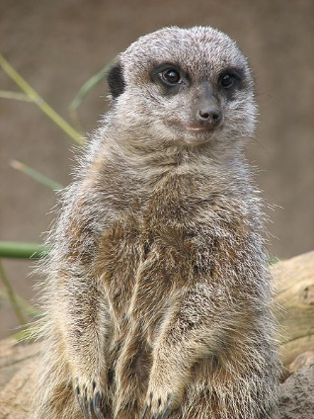
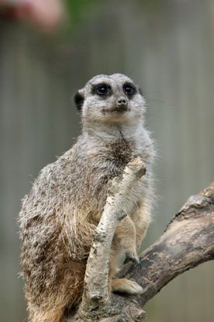
Our aim today

Slide 5



AI vs Machine Learning vs Deep Learning
Artificial Intelligence
Machine Learning
Deep Learning
Notes:
AI – A program that can sense, reason, act and adapt.
Machine Learning – algorithms where the performance improves as they see more data over time.
Deep Learning – a subset in which vast, multi-layered networks learn ever more complex representations from mass amounts of data.

Slide 6
AI
Machine Learning
Deep Learning

Slide 7

Deep Learning Neural Networks for Image Classification
What is a Neural Network?
A computational model that works in a similar way to the neurons in the human brain. Each neuron takes an input, performs some operations then passes the output to the following neuron.
Learns to map inputs to outputs. Neurons have a weight that influences output values.
To train, we predict a value, calculate a “loss” value to express the “error” then update the weights to reduce the error

Slide 8
Deep Learning Neural Networks for Image Classification
Convolutional Neural Networks
Convolutional Neural Networks (CNNs) are one of the main approaches to image classification using Neural Networks.
CNNs treat images as arrays of pixels and learn individual “filters” that spot the features of interest in images that we are attempting to classify.

Slide 9
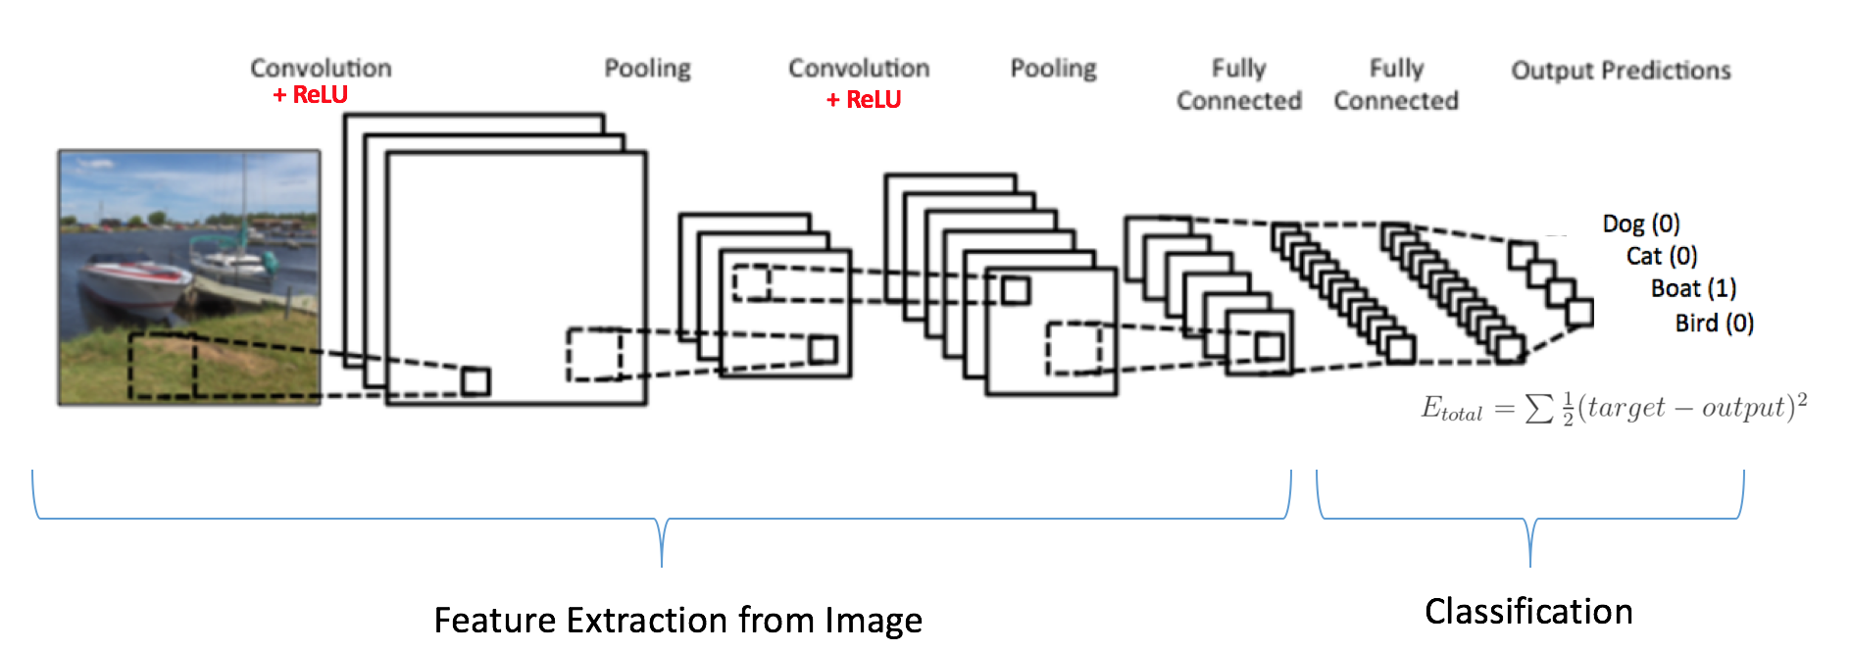
Deep Learning Neural Networks for Image Classification
Convolutional Neural Networks

Slide 10
The Process & The Parts
To implement a Machine Learning solution, what do we need and how do we do it?
Dataset
Pre-Processing
Model
Training & Evaluation
Using our Model
Suitably large
Free from bias
Format data
Remove noise
Model structure
Number and type of layers
Layer parameters
Metrics of interest
Loss function
Consistent pre-processing
Use of new data
Training, Validation, Testing

Slide 11
Demo
A CNN Image Classification tool
https://sistem2020web.z19.web.core.windows.net/
https://colab.research.google.com/drive/1WDULuIj1EDVl53exJioYekbFkh9URW9Y#scrollTo=6AWGOsu5JWZg

Slide 12




Have a go!
Build your own Image Classification Model.
In this workshop, have a go at building a Machine Learning Model.

Slide 13
Have a go
Links
Workshop PDF
https://bit.ly/2I2MSGW

